Slide 1
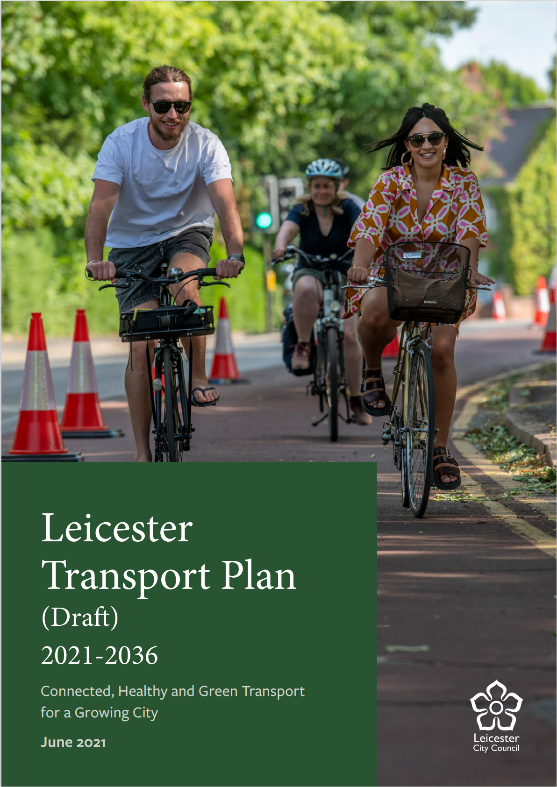
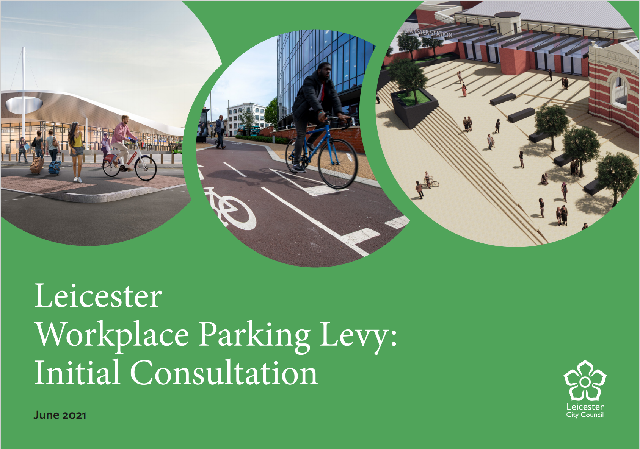
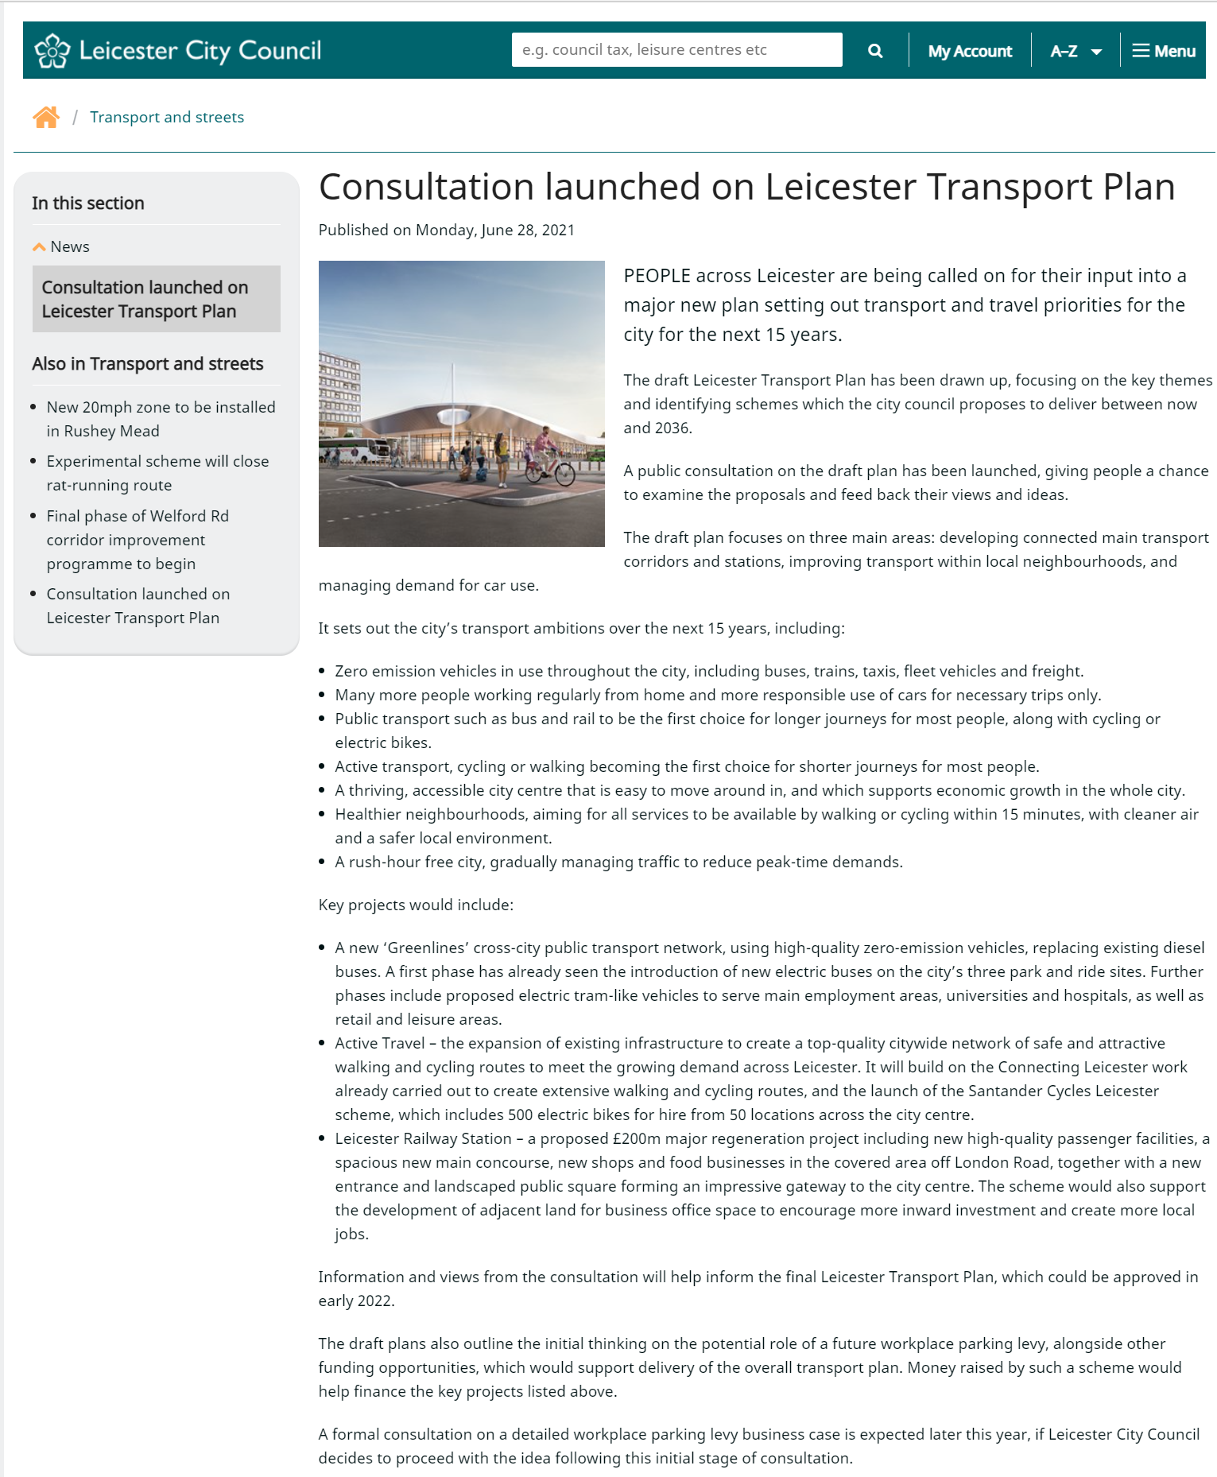
Pro Con Event
Sept 2021
Leicester Transport Plan
&
Workplace Parking Levy Consultation

Slide 2
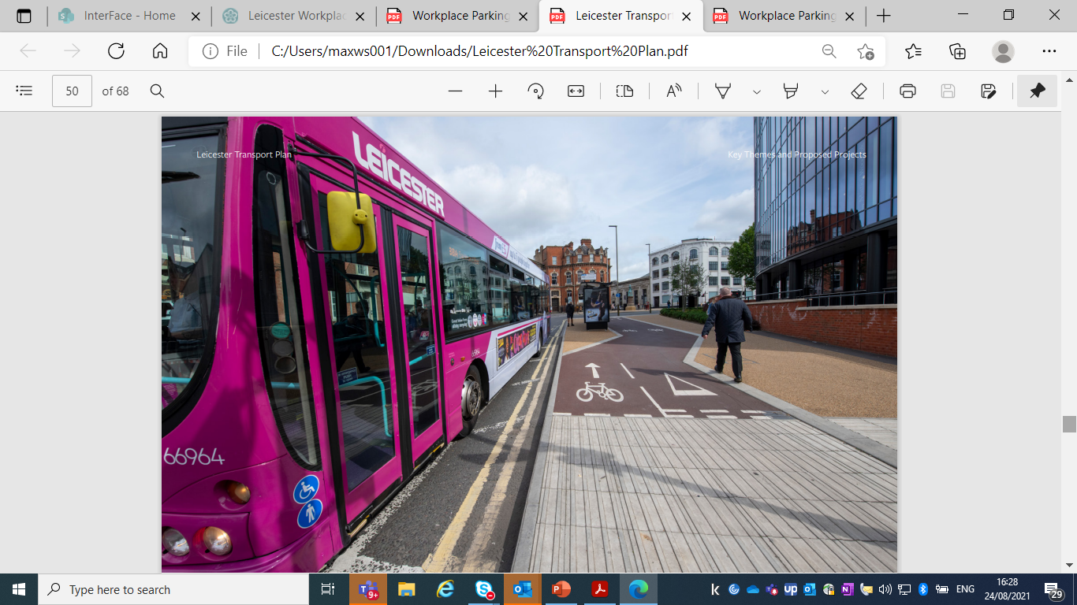
Presentation Overview
Why do we need a new LTP?
  Gov’t Decarbonisation Plan
Recent Projects
Challenges & Opportunities
Transport Vision, Priorities & Funding
Workplace Parking Levy
Consultation Timetable
Questions

Slide 3
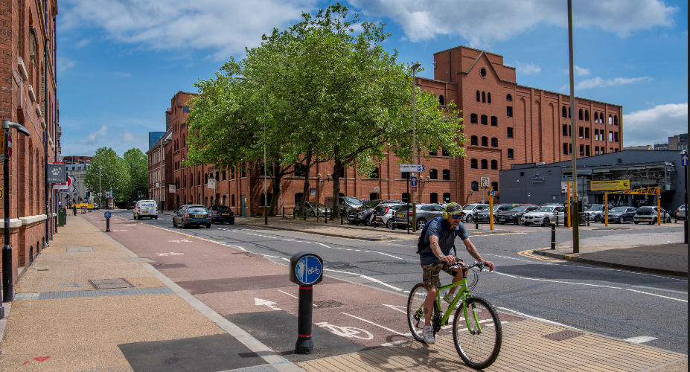
Why do we need a new Local Transport Plan?
New context and new vision – climate emergency/air quality agenda/health agenda/ city and county housing and economic growth plans
“Decarbonising Transport” Government Plan

Slide 4
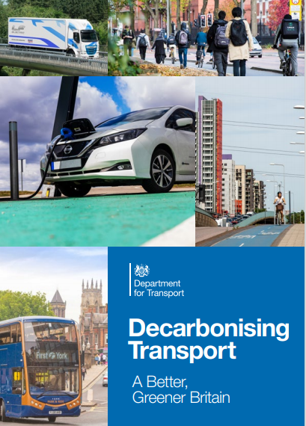
Decarbonising Transport
The Government Plan – July 2021
  Law - emissions net zero by 2050
  Transport - 27% UK GHG emissions
  Largest domestic GHG contributor
  Broadly flat for the last 30 years
  Step change in scale & pace needed
  Opportunity to:
    Improve air quality, noise & health,
    reduce congestion and
    deliver high-quality jobs & growth

Slide 5
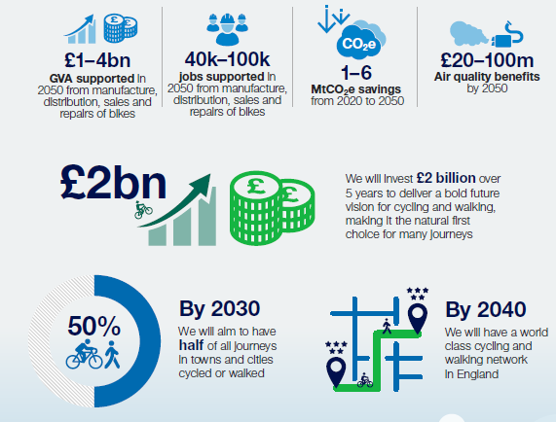
Decarbonising Transport
The Government Plan – July 2021
  Gov’t – Walking & Cycling Commitments

Slide 6
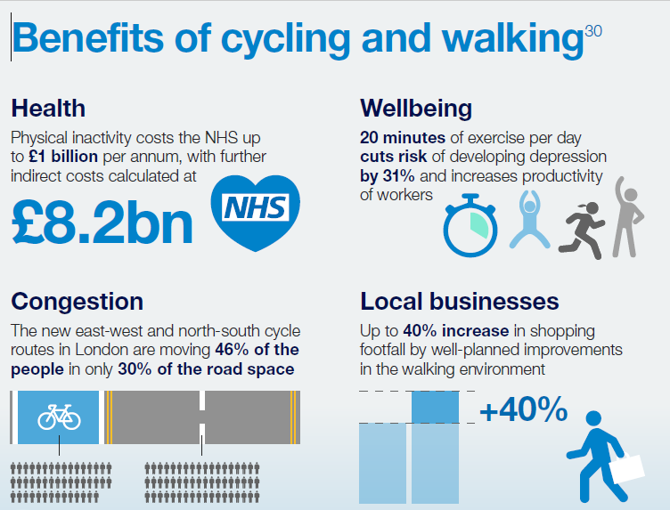
Decarbonising Transport
The Government Plan – July 2021

Slide 7
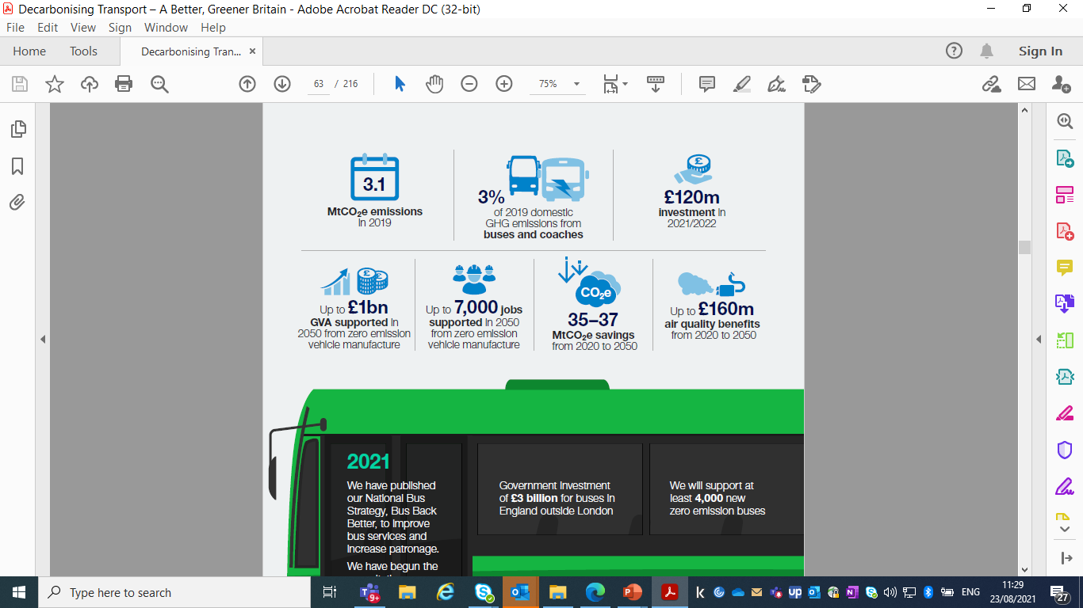
Decarbonising Transport
The Government Plan – July 2021
  DfT – Zero Emission Buses & Coaches

Slide 8
Gov’t delivering decarbonisation through places
Embed transport decarbonisation in planning/transport policy
£12+ bn to support local delivery of transport decarbonisation
Support for LAs to reduce transport carbon emissions
LTP & WPL policies & programmes are well aligned with Government plans

Slide 9
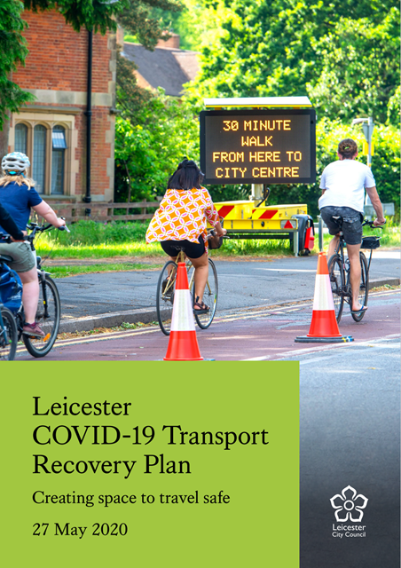
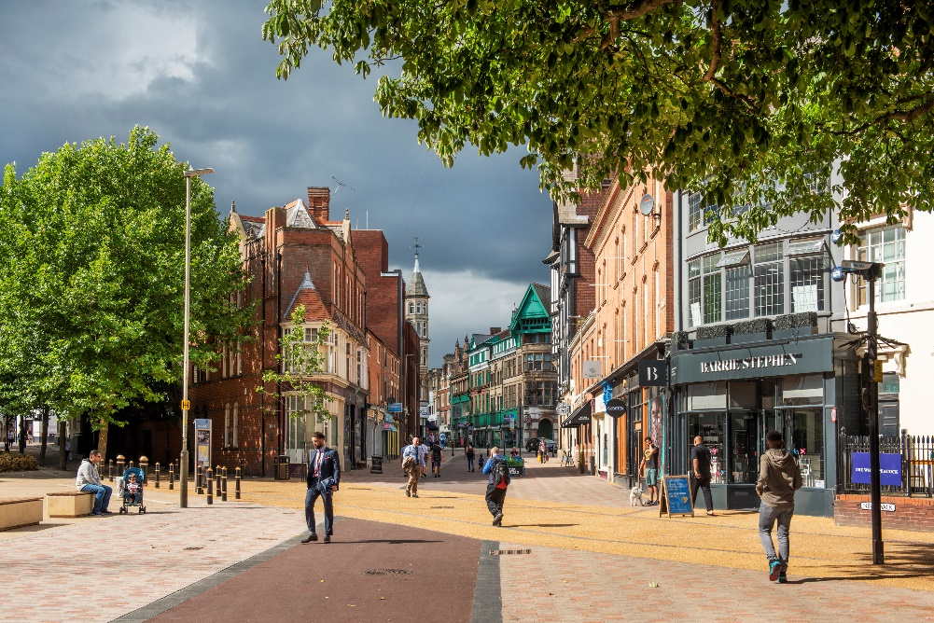
What have we been doing?
2011 - 2021
Connecting Leicester £100m+ investment since 2011
National Productivity Inv. Fund - £7.8m
Air Quality Action Plan – 2020 Compliance achieved
COVID-19 Transport Recovery Plan

Slide 10
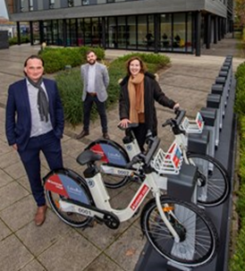
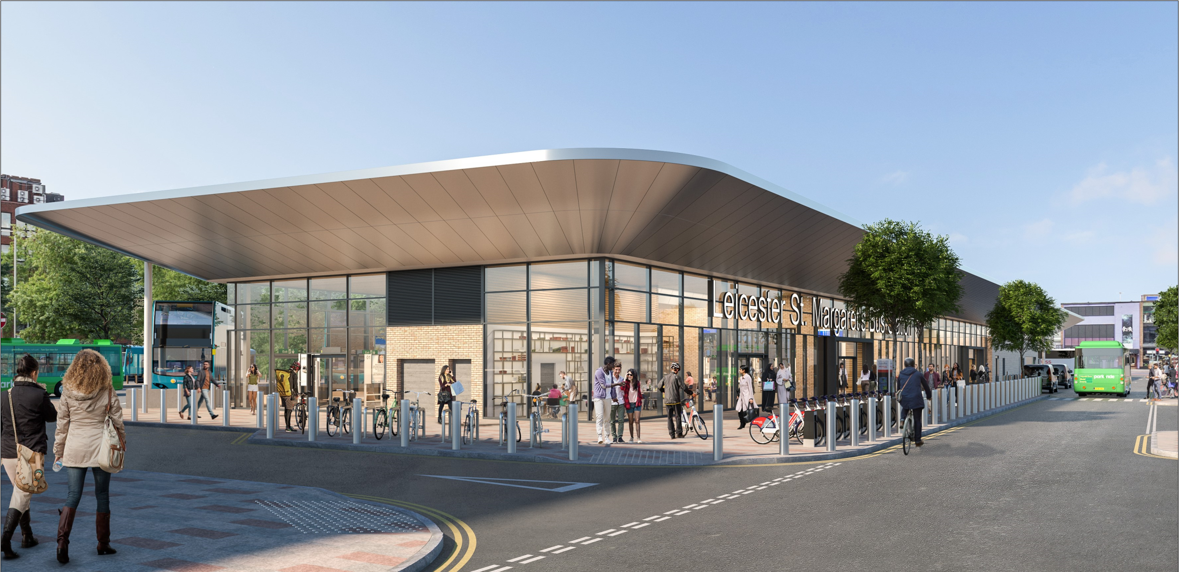
What are we doing?
2021 - 2024
£80million Transforming Cities Fund investment in public transport, cycling and walking
£13.5 million Getting Building Fund
£3.2m – various active travel projects

Slide 11
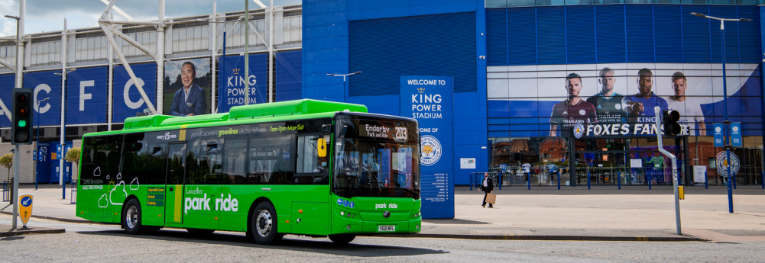
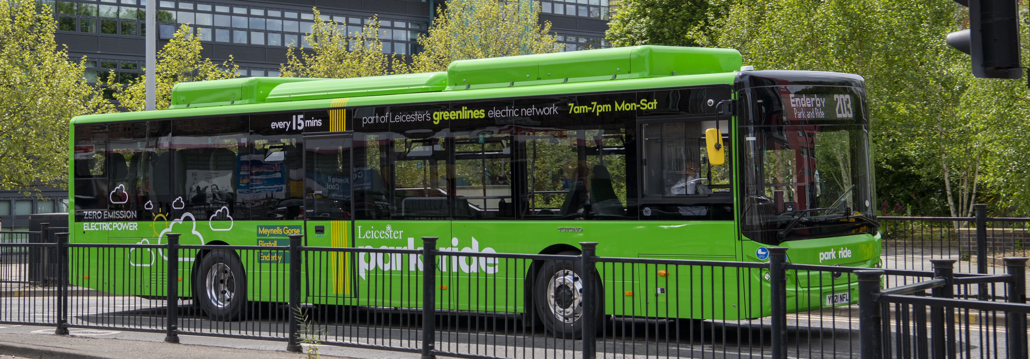
What are we doing? 2021 - 2024
New Enhanced Bus Partnership
Electrified 3 P&R sites
£50m ZEBRA electric bus application submitted – August 21
  98 buses / 30% of Leicester fleet if successful
  Simplifying fares and ticketing

Slide 12
Challenges and Opportunities
  Tackling Climate Emergency
  Enabling Growth
  Improving Health & Activity Levels
  Improving Accessibility and Transport Choice
  Impact of COVID-19
  Carbon neutral target by 2030
  13% pop’n growth in city by 2036
  13th worst for congestion
  33% residents physically inactive
  25% car journeys under 2Km
  Bus journeys declined nationally since 2011
  Cheap commuter parking Compact city – e.g. journey to centre
  bus 30 min; cycle 10 mins (for 50% pop’n)
  Bus use @60%
  Car use @95% - but less peaky
  Increase in cycling & walking
  Air pollution below EU levels;

Slide 13
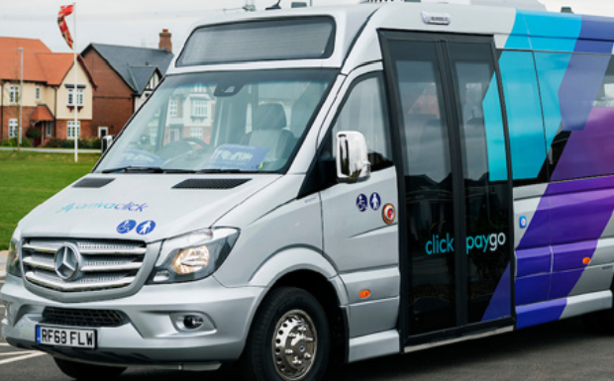
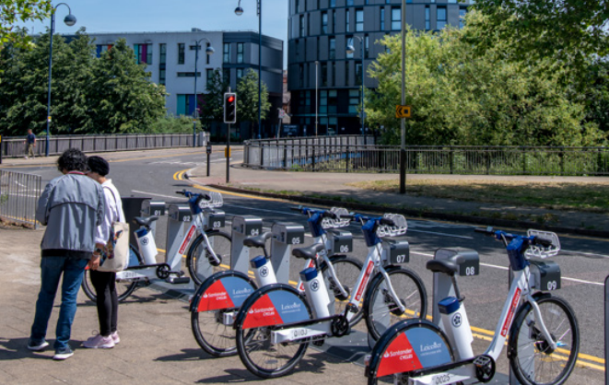
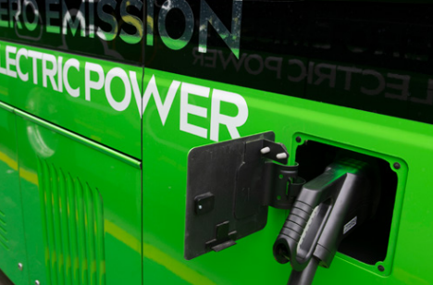
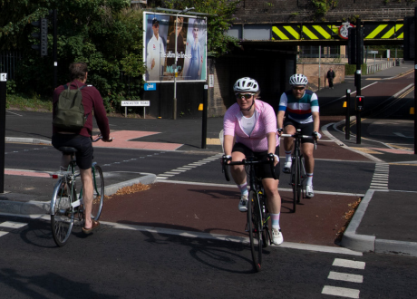
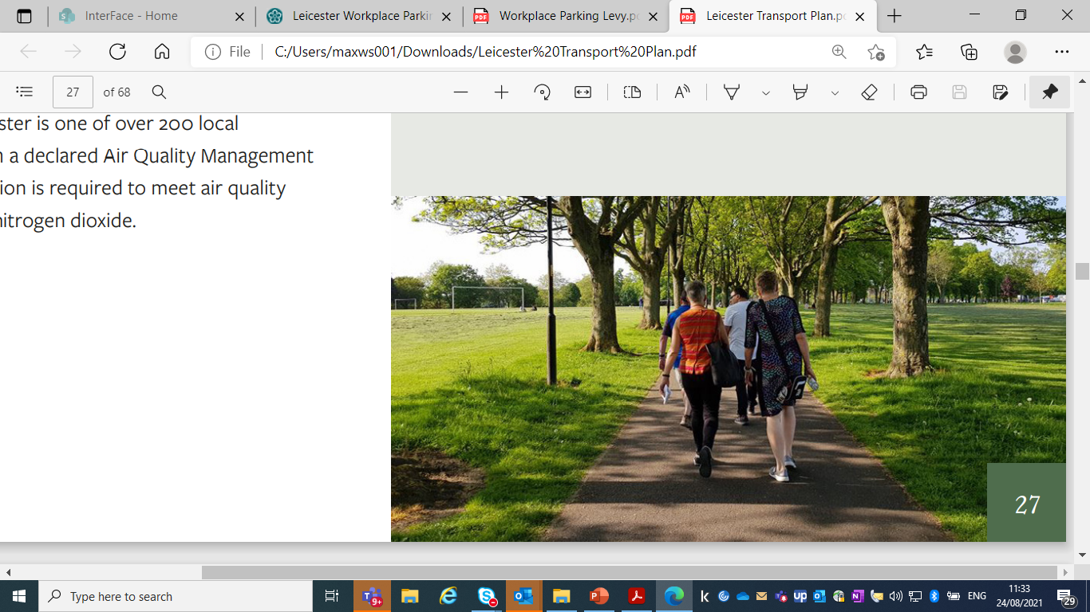
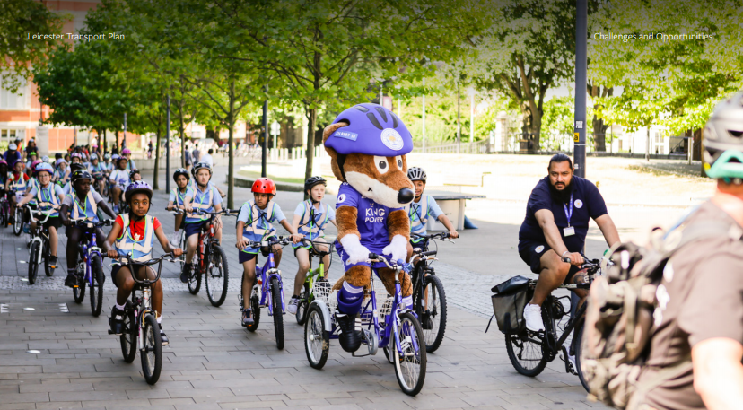
Transport Vision - carbon neutral, growing, healthy, accessible and connected city, with clean air supporting a high quality of life and travel experience for people and a vibrant local economy
Ambitions for 2036:
100% zero emission vehicles
More working from home / more responsible car use
Sustainable modes – first choice for longer journeys for most people.
Active travel - first choice for shorter journeys for most people
A thriving & easily accessible city centre that supports city-wide economic growth
Healthier neighbourhoods
  local services within 15 minutes walk or cycle
  cleaner air / safer environment
Rush-hour free city – manage traffic to reduce peak demands

Slide 14
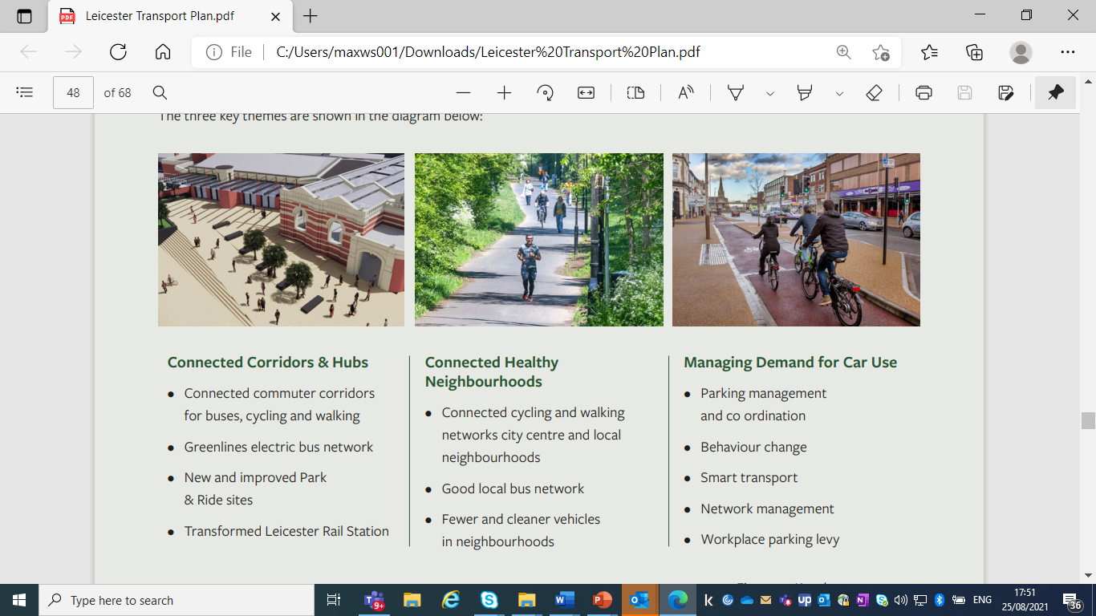
Key Transport Plan Themes

Slide 15
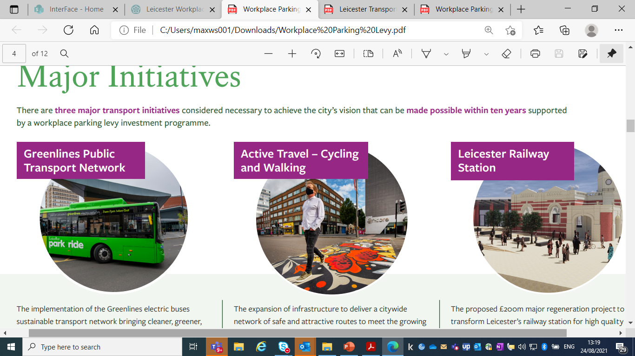
What are our Priorities? – next 10 years
Zero emission electric buses
P&R complete
Zebra bid for 98 buses submitted to DfT
Future – Greenlines electric 'tram-like’ network to serve key employment sites - retail / hospital / uni
citywide network of safe and attractive routes
Continue Connecting Leicester & launch of Santander Cycles
Future - significant expansion;
Improved & new cycle lanes & public realm
Safer neighbourhoods
clean air – healthy city.
Proposed £200m major regeneration project
Transform station - catalyst for investment & jobs
High quality facilities & spacious concourse/retail
Transform
urban realm

Slide 16
How do we fund this?
National, regional and local funding sources such as Government, Midlands Connect and LLEP
External funding – usually via ad-hoc govt & ERDF competitive match-funding based bids
Longer term LA funding? – may return under DfT Decarbonisation Plan
Inevitably still require local match-funding
Hence WPL consultation
Offers ongoing/reliable source of funding – 10+ years
Note
Nottingham raised £75million since 2012
leveraged over £680million transport investment
Funded tram

Slide 17
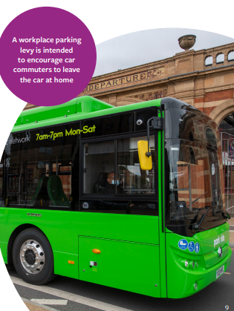
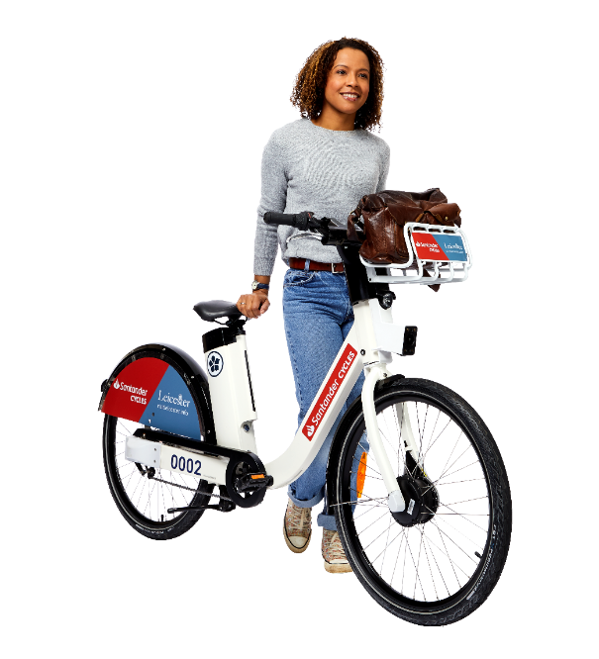
What is a Workplace Parking Levy?
Aim
encourage sustainable transport
Secure wider environmental / health benefits & reduce public health costs and support economic growth
charge on employers for parking places used by car commuters
employers can pass on, pay or share charge with employees
businesses, public sector, education organisations
Customers and residential parking excluded
ring-fenced for transport investment

Slide 18
Workplace Parking Levy Features
Proposed operating area- within City council administrative boundary
Levy charge - around £550 per chargeable parking space per year (TBC)
Equates to annual bus pass from main operators
Around £2 per working day
Exemptions and discounts – e.g. small businesses
Assessment of environmental, economic and equalities impact as part of full business case

Slide 19
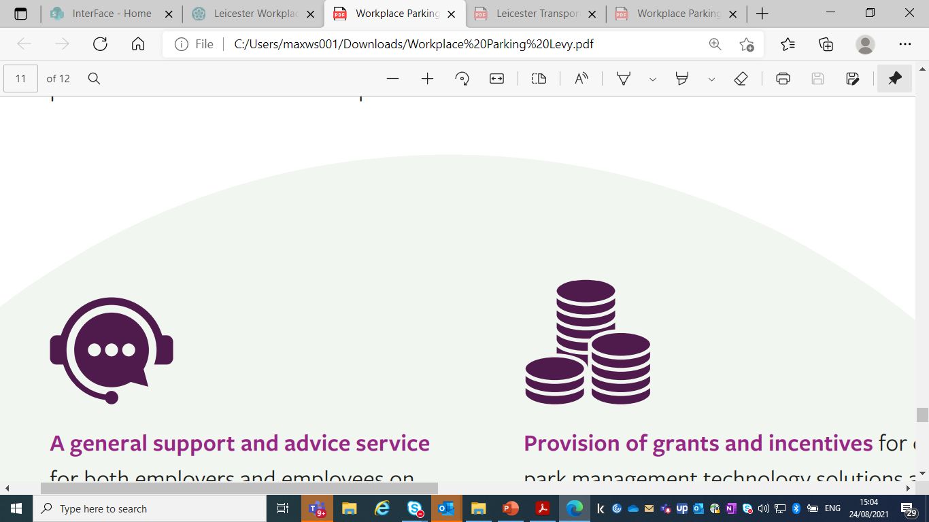
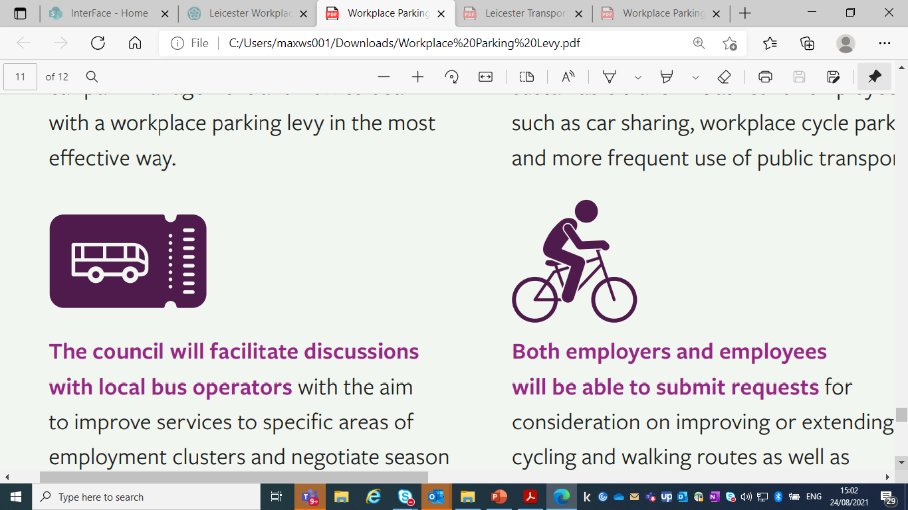
WPL Business Advice & Support
How to deal with levy in the most effective way
Car park management
Work with employers & bus ops to improve services
Help negotiate ticket deals for employees
Grants and incentives
Sustainable travel initiatives
Car sharing
Cycle parking
Work with employers / employees to improve cycling and walking routes

Slide 20
LTP/WPL Timetable
25 Jun – 17 Sept: LTP / initial WPL consultations
Nov 21: Publish Consultations report
Nov – Dec: WPL formal business case consultation
Spring 22: Council consideration of LTP final document & WPL business case +Business case to Secretary of State
Autumn 22: if approved …WPL mobilised
Early 23: WPL charging commences

